Slide 1


Re-establish Baseline from a Previous Audiogram Practicum
Tri-Service Hearing Technician
4.2 Certification Course

Slide 2
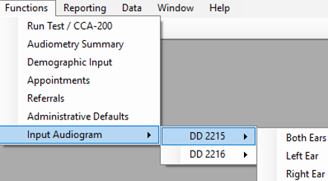
Re-establish Baseline from a Previous Audiogram Practicum
Learning Objectives
4.2.1 Manually re-establish a baseline from a previous audiogram
4.2.2 Enter an electronic remark to cover the authority for the re- established baseline
Tri-Service Hearing Technician 4.2.0.0 Certification Course

Slide 3
Re-establish Baseline from a Previous Audiogram Practicum
Audiometry Summary
Do a DR inquire on the patient to bring back any records from the DR that are not in your local database
  Done automatically if you are on a DOEHRS-HC work station that is connected to the internet
Review the audiograms covered by the referral
  Re-establish only the ear(s) that have an STS present
Review audiologist instructions
Re-establish baseline
  Technician was/is the examiner on the audiogram
  Electronic remark to cover the authority for the re-established baseline
Tri-Service Hearing Technician 4.2.0.0 Certification Course

Slide 4
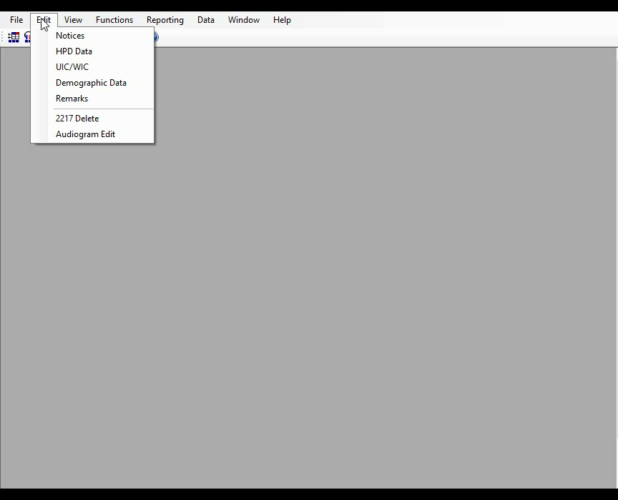
Notes:
2 minute video - Re-establish Baseline from a Previous Audiogram (shows how to re-establish baseline from a previous audiogram)
Same prompts appear in the run test window after a Follow-up 2 test if an STS is present.

Slide 5
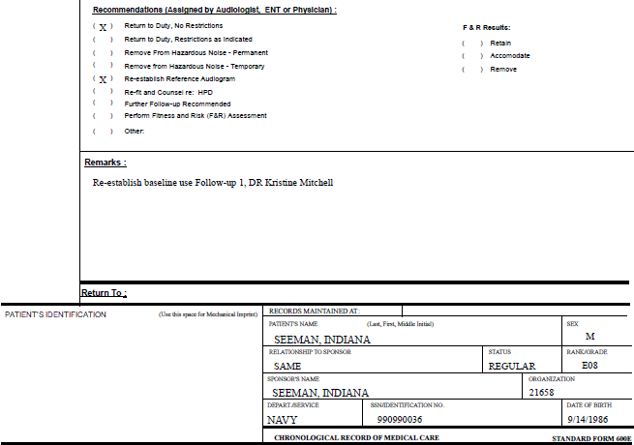
Follow referral instructions on page 128
Notes:
Patient Referral on page 128

Slide 6
Re-establish Baseline from a Previous Audiogram Practicum
Complete Practicum
Never re-establish a baseline on a positive STS without audiologist approval
Briefly review patient history
Review referral instructions
Never edit a test to change the test type
Functions>Input Audiogram>DD 2215>…
Input patient SSN 990990036
Read prompts that appear
Follow referral instructions (test selection)
Input electronic remark
Tri-Service Hearing Technician 4.2.0.0 Certification Course
Notes:
Leave this slide up while checking the students work.

Slide 7
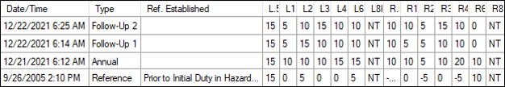
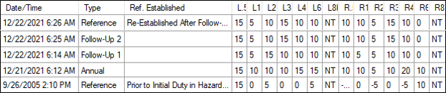
Re-establish Baseline from a Previous Audiogram Practicum
Patient Audiometry Summary
Prior to re-establishment
After re-establishment
Tri-Service Hearing Technician 4.2.0.0 Certification Course

Slide 8
Re-establish Baseline from a Previous Audiogram Practicum
Summary
Manually re-establish a baseline from a previous audiogram
Enter an electronic remark to cover the authority for the re-established baseline
Never re-establish a baseline on a positive STS without audiologist approval
Tri-Service Hearing Technician 4.2.0.0 Certification Course

Slide 9
Re-establish Baseline from a Previous Audiogram Practicum
? Questions ?
Tri-Service Hearing Technician
4.2 Certification Course

